Slide 1
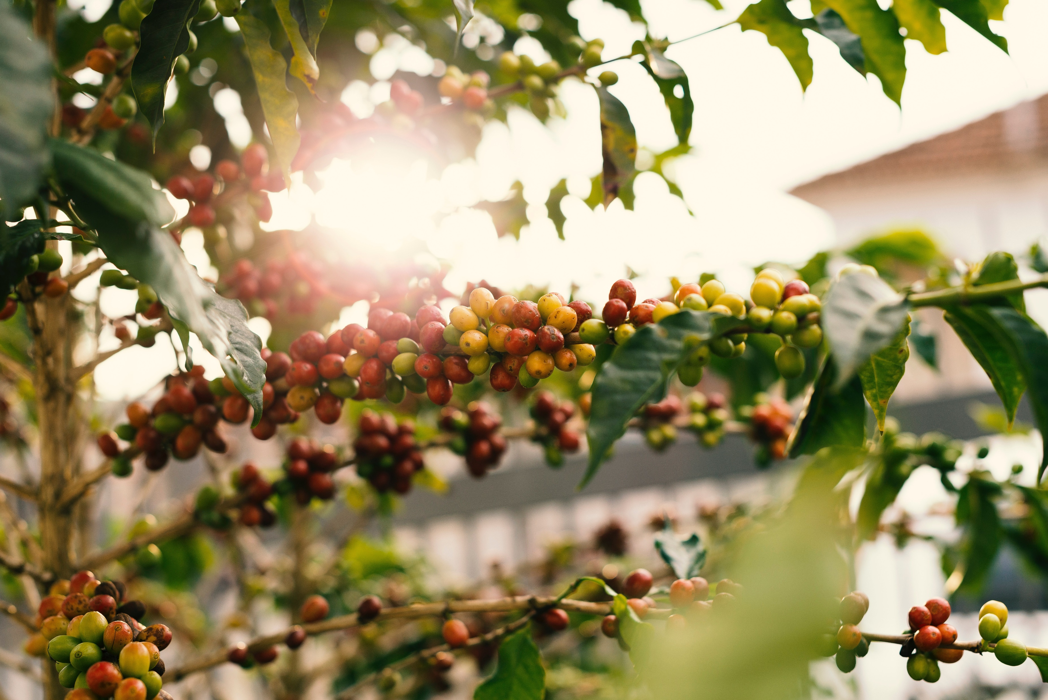
CLIMATE FORECAST
IN AUSTRILIA
COFFEE QUALITY
FORECAST IN XXXXX
GROUP 8 COFFEE
Names here

Slide 2

CLIMATE FORECAST
IN AUSTRILIA
COFFEE QUALITY
FORECAST IN XXXXX
GROUP 8 COFFEE
Names here

Slide 3

INTRODUCTION
BACKGROUND
Data Source - Coffee Quality Institute (CQI)
CQI is a non-profit organization dedicated to improving the lives of producers through research to improve the quality of coffee.
DATA
Overall content - Features of coffee and its production (including an overall quality score for the batch)
AIMs
How do the different features of coffee affect whether a batch of coffee is of good or bad quality?
Generalised Linear Model (GLM)
Notes:
穿插加入气候变化影响的图片。修改小标题的格式。

Slide 4
C
OUTLINE
GROUP8+TITLE HERE
/
/
/
/
EXPLANATORY ANALYSIS
METHOD
RESULT
EXTENSION
CONCLUSION
Generalized Linear
Model (GLM)
Model comparison
Best model
Residential check
Model evaluation
Bulaabulduahsklfhaosdfiuaksdjfnlkasdfjhaksdfhlaskdfhakjfhaksjdhfksjdhfkjshfks
Bulaabulduahsklfhaosdfiuaksdjfnlkasdfjhaksdfhlaskdfhakjfhaksjdhfksjdhfkjshfks
Data handling
Data visualization
Notes:
确定各个section的名称即其后添加的小标题。

Slide 5
EXPLANATORY ANALYSIS
DATA
Variables
country_of_origin – Country where the coffee bean originates from.
aroma – Aroma grade (ranging from 0-10)
flavor – Flavour grade (ranging from 0-10)
acidity – Acidity grade (ranging from 0-10)
category_two_defects – Count of category 2 type defects in the batch of coffee beans tested.
altitiude_mean_meters – Mean altitude of the growers farm (in metres)
harvested – Year the batch was harvested
Qualityclass – Quality score for the batch (Good - ≥ 82.5, Poor - <82.5). Note: 82.5 was selected as the cut off as this is the median score for all the batches tested.
Preprocessing
Delete columns with NA values
Notes:
还会用到sarima（在下一页）
A model well-fitted to climate data to predict future weather(副标题)

Slide 6
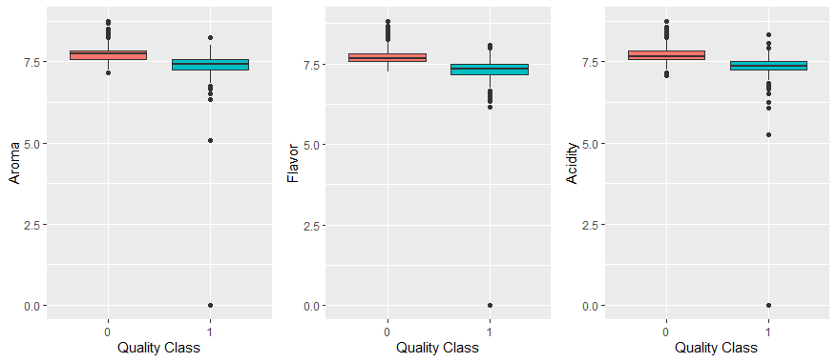
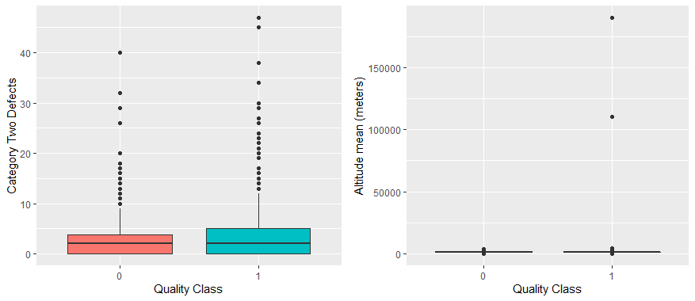
BOXPLOT
Figure 1
How figures look like
Some analysis
Figure 2

Slide 7
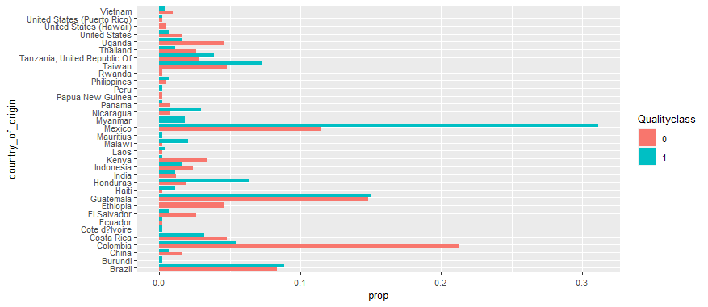
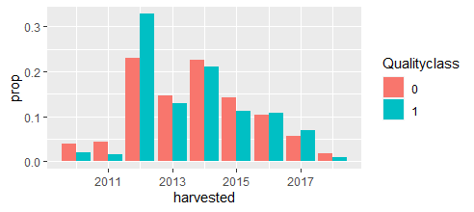
Figure 3
Some explanation
BAR CHART
Figure 4

Slide 8
BOXPLOT
数据看起来如何
Possible reason:
Figure 1
TITLE
数据看起来如何
Figure 2
一些推测

Slide 9
TITLE

Slide 10
TITLE
Notes:
给figure贴图

Slide 11
TITLE
Notes:
绿色部分修改

Slide 12
TITLE
Data visualization
TITLE and TITLE
SDFSADGGFDHFGDHDFGDFGD
ASDASDASDASDFGSDGHSFDGSDFGDF
TITLE
ASDASDASDASDASDASDASD
XDASDASDASDA

Slide 13
Best model
SADASDASDASDASD
ASDASDASDASDASDASDASDASDASDASD
ASDASDASFGADFASDFASDFASDFASDFASDFASF
STATIONARY
Figure7
Table1 : TABLENAME HERE

Slide 14


Best model
Table2 : TABLE NAME
xxxxxx analysis
SUBTITLE:
POINTS
SUBTITLE
POINTS
Table3 : TABLE NAMES
TITLE:
POINTS
POINTS
POINTS
Notes:
Find model 和表格每行一一对应

Slide 15

Model diagnostic
TITLE
Table: TABLE NAME
Figure : FIGURE NAME
POINTS
POINTS
Table : TABLE NAME
Notes:
红色部分待添加

Slide 16
Forecast TITLE
Figure9 : NAME
Figure10 : NAME
Figure11 NAME
Figure12 : NAME

Slide 17
Extension and Discussion
TITLE
Figure
POINTS
TITLE
EXPLANATION:
POINTS
POINTS
POINTS
Figure
POINTS

Slide 18
title
title
1
2
3
4
1
2
3
4
title
1
2
3
4
Figure
title
1
2
3
4
Figure
Figure

Slide 19
title
1
2
Figure
sdafasdfasdfasdfasdf
Figure

Slide 20
DATA HANDLING
Variables
country_of_origin – Country where the coffee bean originates from.
aroma – Aroma grade (ranging from 0-10)
flavor – Flavour grade (ranging from 0-10)
acidity – Acidity grade (ranging from 0-10)
category_two_defects – Count of category 2 type defects in the batch of coffee beans tested.
altitiude_mean_meters – Mean altitude of the growers farm (in metres)
harvested – Year the batch was harvested
Qualityclass – Quality score for the batch (Good - ≥ 82.5, Poor - <82.5). Note: 82.5 was selected as the cut off as this is the median score for all the batches tested.
Preprocessing
Delete columns with NA values
Notes:
穿插加入气候变化影响的图片。修改小标题的格式。

Slide 21
BOXPLOT
数据看起来如何
Possible reason:
Figure 1
SARIMA is the improvement of ARIMA. Which is applicable for weather data with seasonal pattern. daskdjasoidujaosijdoaisjdoi

Slide 22
Conclusion
Model performance
BASIC EXPRESSION
POINT
POINT
POINT
Trend in future
POINTS
Model evaluation at other cities:

Slide 23
title
1
2
3
4
5
title
1
2
3
4
5
6
7
8
9
10
title
1
2
3
Notes:
画箭头

Slide 24
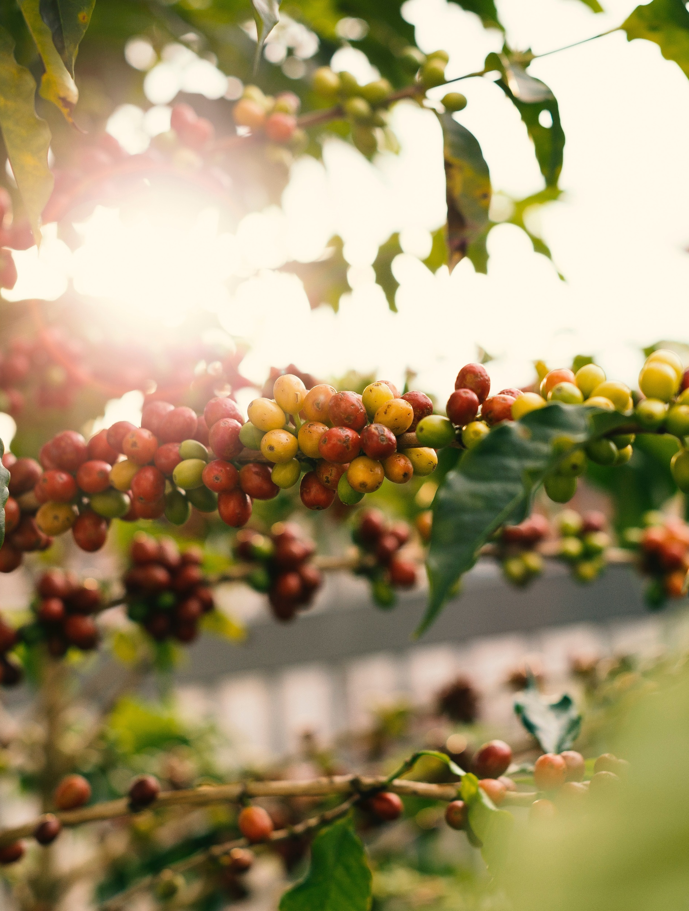
COFFEE QUALITY
FORECAST IN XXXXX
NAMES HERE

Slide 25

REFERENCE
REFERENCE
https://www.statista.com/topics/5945/coffee-market-worldwide/#topicHeader__wrapper

Slide 26
THANKS FOR LISTENING
Q&A
GROUP 8 + Title

